Slide 1
Percentages
WALT: Find Percentage increase and decrease using a multiplier.

Slide 2
Starter
Write the following percentages as fractions and decimals:
50%
25%
17%
33%
5%
1%
99%
100%
13.5%
125%

Slide 3
Percentages
Find 48% of 128
Find 27% of 548

Slide 4
Percentage increase
The value of Frank’s house has gone up by 20% in the last year. If the house was worth £150 000 1 year ago, how much is it worth now?
Find the result in a single calculation.
The original amount is 100%:
100%
20%
Now we add 20%
We now have 120%
Notes:
Remind pupils that 100% of the original amount is like one times the original amount: it remains unchanged. 100% means ‘all of it’.
When we add on 20% we are adding on 20% to the original amount, 100%, to make 120% of the original amount.
Ask pupils why might it be better to find 120% than to find 20% and add it on.
Establish that it’s quicker because we can do the calculation in one step.
Discuss how 120% can be written as a decimal.

Slide 5
120%
=
120
=
1.20
100
So multiply by 1.2

Slide 6
So……………..
120% of £150 000 = 1.2 × £150 000
So house is worth= £180 000

Slide 7
Percentage increase | Multiplier for percentage increase
10%
1.1
25%
1.25
17%
1.17
1%
1.01
5%
1.05
33.5%
1.335
7%
1.07
24.3%
1.243

Slide 8
Percentage increase
Here are some more examples using this method
Increase £50 by 60%.
160% × £50 =
1.6 × £50
= £80
Increase £86 by 7%.
107% × £86 =
1.07 × £86
= £92.02
Notes:
Talk through each example as it appears. Explain the significance of finding a 17.5% increase in relation to VAT.

Slide 9
Try these….using a multiplier
Increase £66 by 22%
Increase £134 by 36%
Increase £246 by 150%
Extension
Jack had lunch in a restaurant. The food he ordered cost £56. He also had to pay 4% service charge.
a. How much was the total cost of his meal?

Slide 10
Percentage decrease
A CD walkman originally costing £75 is reduced by 30% in a sale. What is the sale price?
The original amount is 100% like this:
70%
100%
30%
Now we subtract 30%
We now have 70% of the original amount.
Notes:
Remind pupils again that 100% of the original amount is like one times the original amount, it remains unchanged. 100% is ‘all of it’.
Explain that when we subtract 30% we are subtracting 30% from the original amount, 100%, to make 70% of the original amount.
Ask pupils why might it be better to find 70% than to find 30% and take it away.
Again, establish that it’s quicker. We can do the calculation in one step.
Discuss how 70% can be written as a decimal.
Conclude that to decrease an amount by 30% we multiply it by 0.7.
Give more verbal examples as necessary.

Slide 11
70%
=
70
=
0.70
100
So multiply by 0.7

Slide 12
So……………..
70% of £75 = 0.7 × £75
So sale price is = £52.50

Slide 13
Percentage decrease | Multiplier for percentage increase
10%
0.9
25%
0.75
17%
0.83
1%
0.99
5%
0.95
33.5%
0.665
7%
0.93
24%
0.76

Slide 14
Percentage decrease
Here are some more examples using this method:
Decrease £65 by 20%.
80% × £65 =
0.8 × £65
= £52
Decrease £320 by 3%.
97% × £320 =
0.97× £320
= £310.40
Notes:
Talk through each example as it appears. Pupils should be able to confidently subtract any given amount from 100 in their heads.

Slide 15
Try these….using a multiplier
Decrease £34 by 25%
Decrease £120 by 8%
Decrease £46 by 18%
Extension
In a sale a DVD player that originally cost £130 was reduced by 20%. John bought the DVD player at the sale price – how much did he pay?

Slide 16
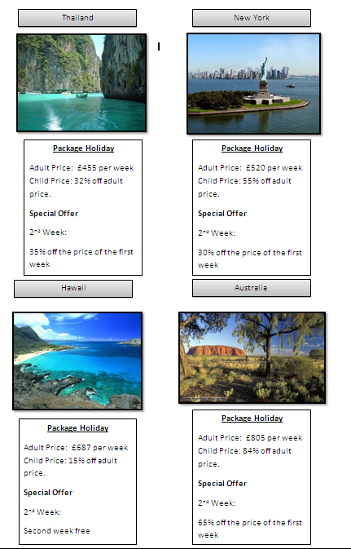
Holidays ☺
I need some help to book my summer holiday.
There are four possible destinations to choose from but I want to find the cheapest deal.
I want to go away for 2 weeks. The holiday is for 2 adults and 2 children.
In pairs work out the cost of each holiday and decide which is the best value.

Slide 17
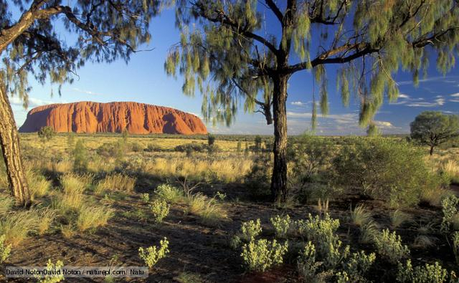

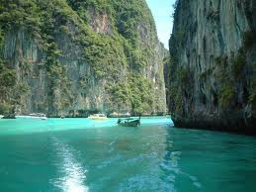
Which holiday?
Thailand - £2522.52
New York - £2563.60
Hawaii - £2541.90
Australia - £2521.26
Cheapest holiday is Australia at £2521.26 for 2 adults and 2 children for 2 weeks.

